Slide 1
Math analysis
Day 22

Slide 2
Objective
Finish Name, and/or Flag Assessments if you have not done so yet, and submit to teams
Replicate the following Patterns
Create your own patterns and/or explore Laces

Slide 3
More Patterns
In Bricklayer Lite Level 3
Save your pattern as 1_Pattern_Name.xml
Save your pattern as 2_Pattern_Name.xml
Save your pattern as 3_Pattern_Name.xml
Load it onto Teams in the More_Patterns folder

Slide 4
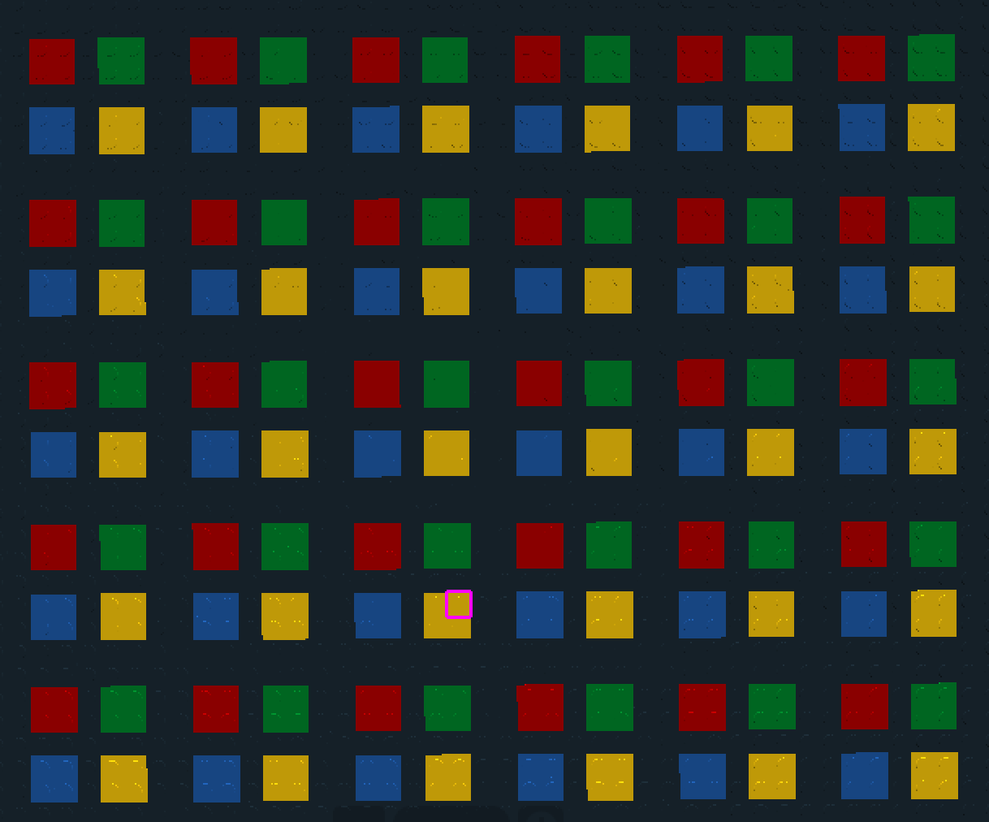
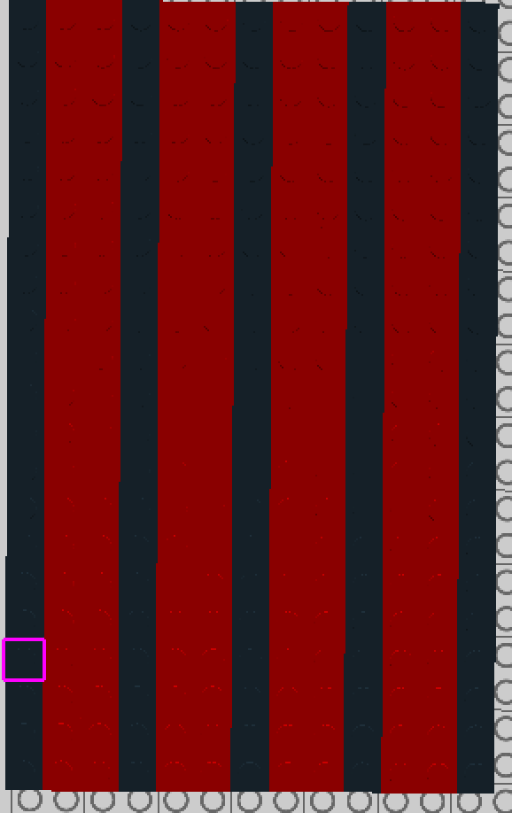
#2
#1

Slide 5

#3
Or some
Variation
Of this
Pattern…

Slide 6
Explore on Your Own… Create Your Own Pattern and or Explore Laces
Things to Explore
Functions inside of functions
Repeat functions
Attempt to use the line function call (not just the put function call)
Explore the shapes function calls
Anything else you haven’t tried yet

Slide 7
Review Saving in Bricklayer Lite to Teams
Change “Filename” make sure it ends with .xml
Click Download XML
Open up Teams
Open the appropriate folder: ______________________
Click “upload” and select your recently downloaded file
Save
*Move the file to your Own Drive from your Downloads folder

